Slide 1
CRYPTOGRAPHIC ACCELERATOR

Slide 2
CRYPTOGRAPHY
Individuals and organizations use cryptography on a daily basis to protect their privacy and keep their conversations and data confidential.
Cryptography has four major goals: confidentiality, integrity, authentication, and non-repudiation.
Cryptography ensures confidentiality by encrypting sent messages using an algorithm with a key only known to the sender and recipient.

Slide 3
ENCRYPTION IN VLSI
In cryptographic applications, the data sent to a remote host are encrypted at the source machine using an encryption key then the encrypted data are sent to the destination machine, where it's decrypted to get the original data, thereby attacker won't have the encryption key which is required to get the original data.
The architecture works for both encryptions as well as for decryptions, which depends upon the external input signal. When the signal external input signal is at logic ‘1’, the controller resides in the Encrypt state and it asserts it to logic high. The architecture performs the encryption operation. Similarly, when the external input signal is at logic low in the Decrypt state, the architecture performs the decryption operation.

Slide 4
ACCELERATOR
Accelerators are used to deploy and integrate security features in a shorter period of time. This indicates that accelerators could be pre-configured modules or frameworks that facilitate rapid implementation of security measures in client environments.
A hardware accelerator is a specialized processor that is designed to perform specific tasks more efficiently than a general-purpose processor.
Hardware accelerators are often used to speed up tasks that are computationally intensive, such as graphics rendering, machine learning, and cryptography.

Slide 5
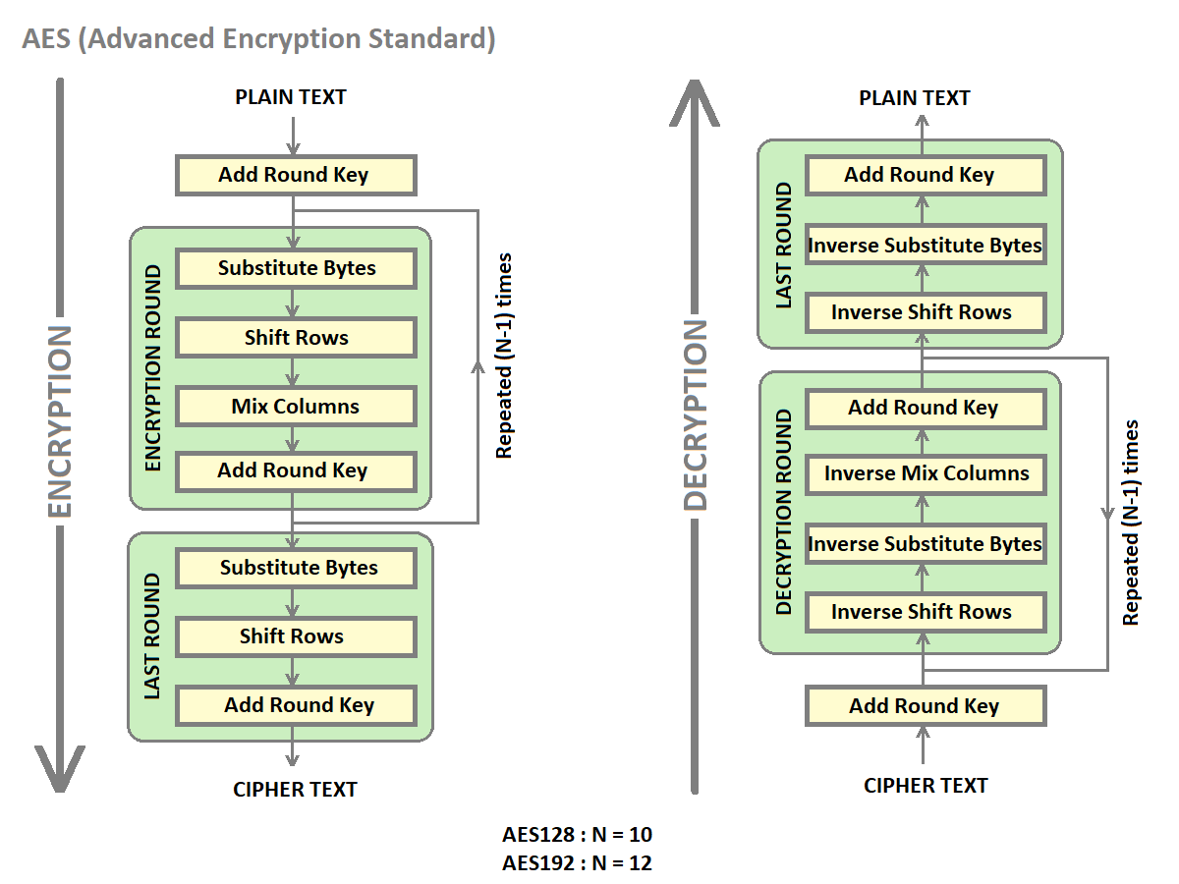
FLOWCHART

Slide 6
APPLICATIONS
Network Security:
Firewall and Intrusion Detection Systems: Accelerators can handle high-throughput encryption/decryption to protect network traffic and detect malicious activities.
VPNs (Virtual Private Networks): They speed up the encryption of data packets to secure communications over potentially untrusted networks.
Financial Transactions:
Payment Processing: Accelerators handle encryption in online transactions, ensuring secure and fast processing of payments.
ATMs and Point-of-Sale Systems: They speed up encryption for card transactions and data protection.

Slide 7
THANK YOU

